Slide 1
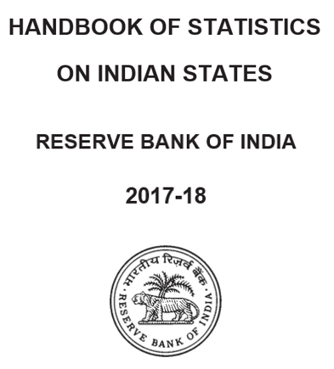
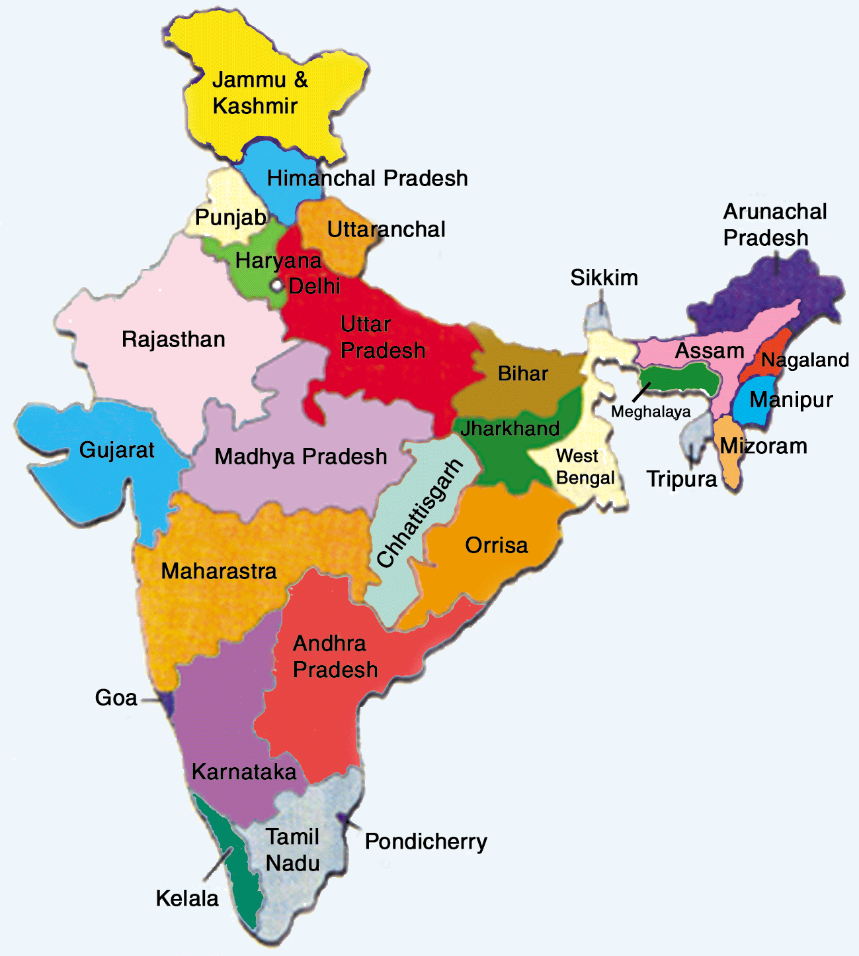
Cluster Analysis: Case Study on Segmentation of Indian States
Data: rbi.csv

Slide 2

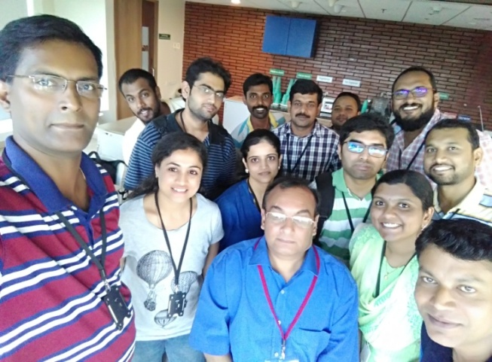
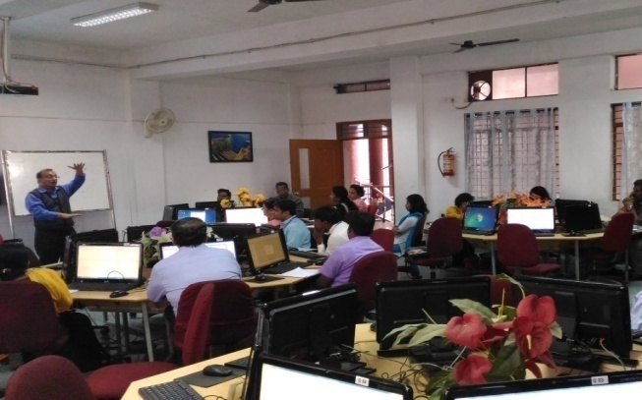
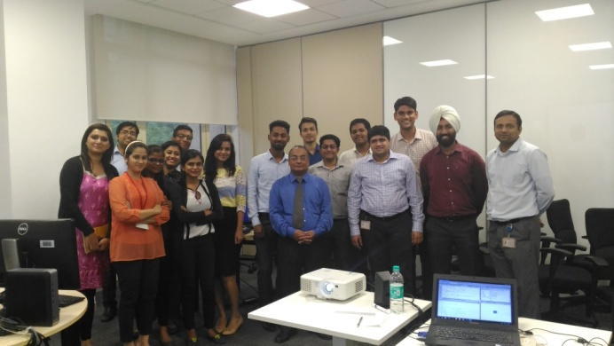
Dr. Vinod Kumar Murti
BE Mechanical
1985, From Samrat Ashok Technological Institute, Vidisha, M.P.
MBA – Finance & Marketing
PhD – Finance
Served Engineering Industry for 17 years
Travelled Germany, Australia, Dubai and Bahrain
In Training & Academics since last 20 years.
Country Head – IoA Business Analytics & Data Analytics
Given Analytics training to Accenture, Capgemini, Hewlett-Packard, Prudential-Global, Goldman Sachs,
ANZ Bank, State Street

Slide 3
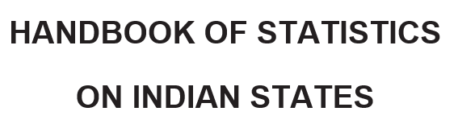
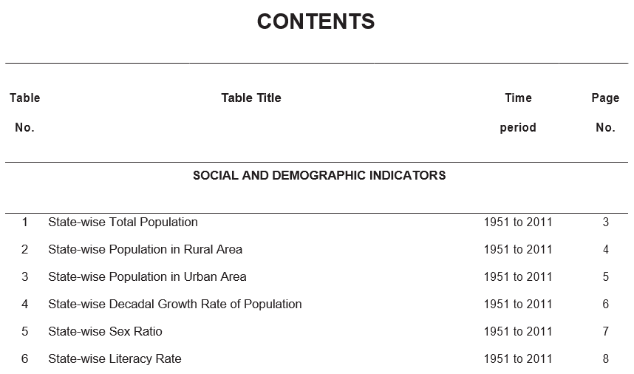
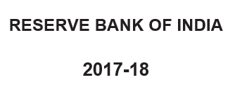

Data Source

Slide 4
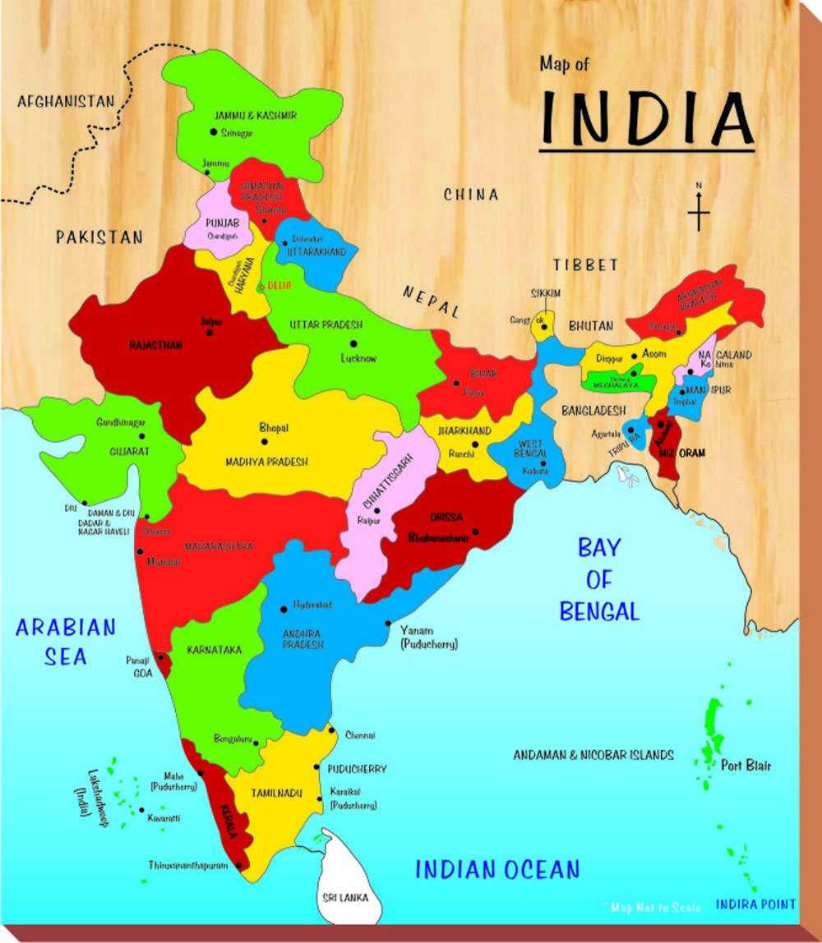

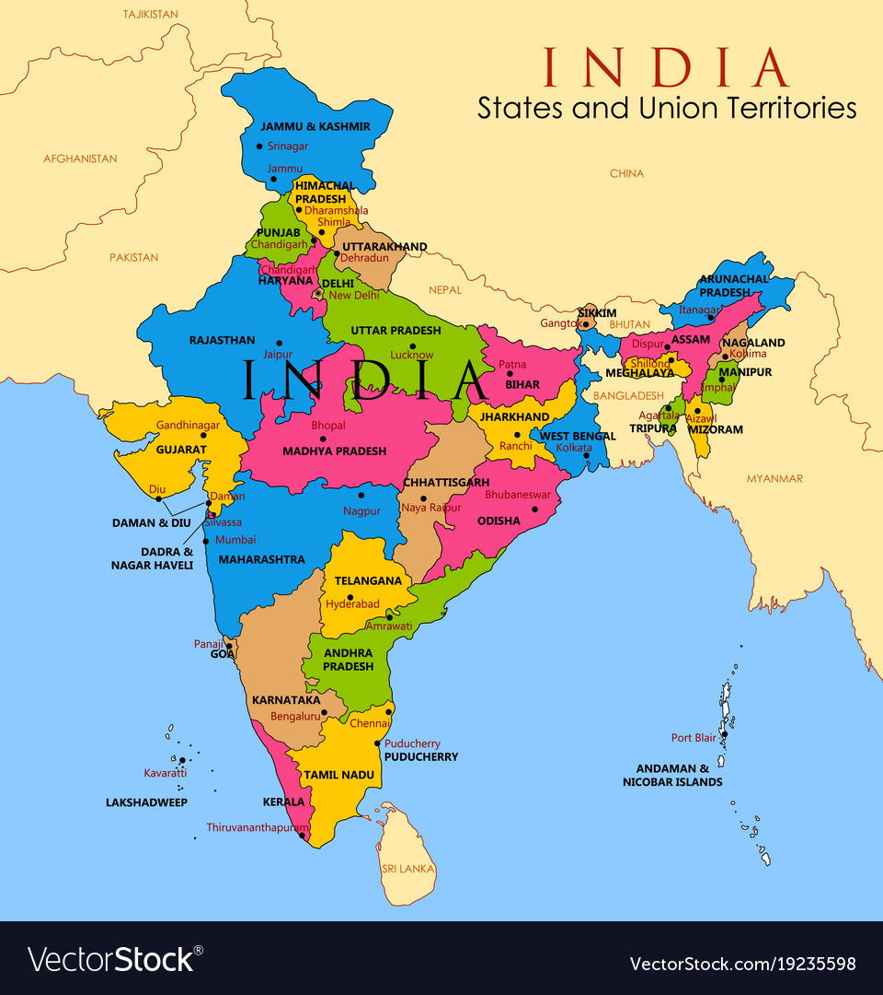

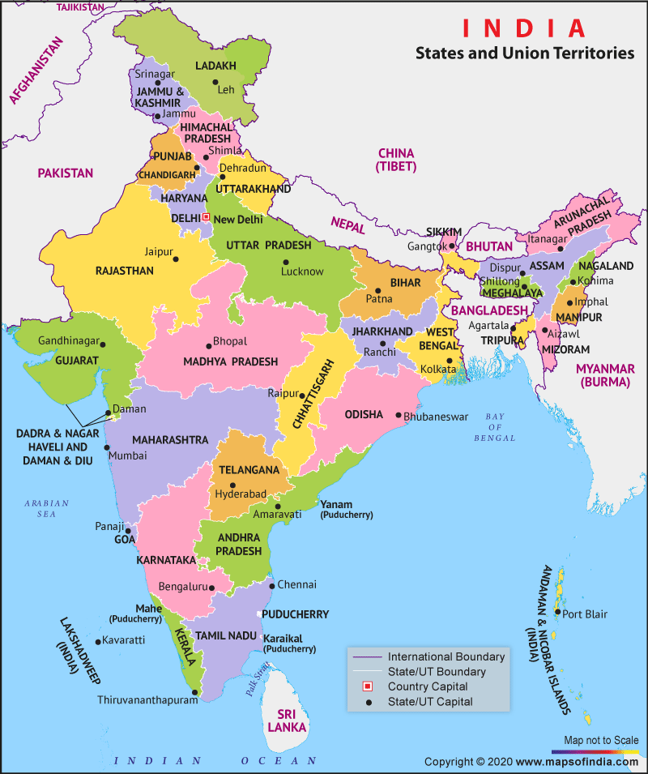
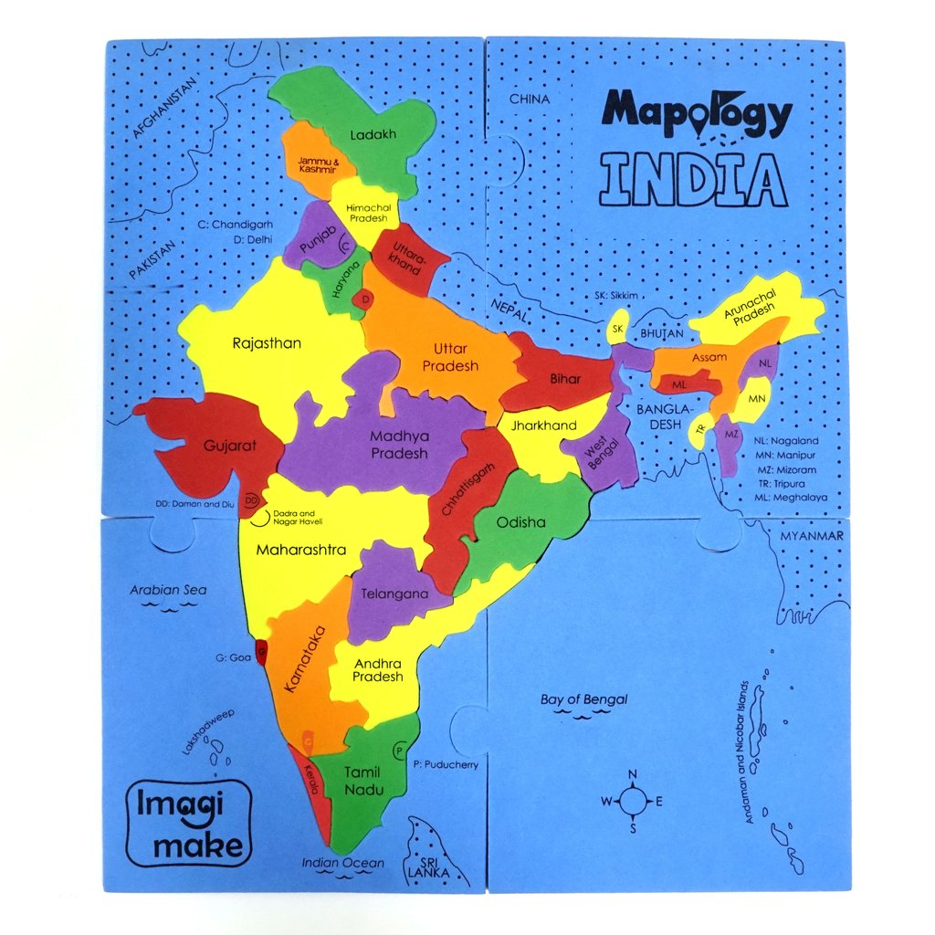
Beneficiaries

Slide 5



Cluster Analysis: The Suspense!

Slide 6
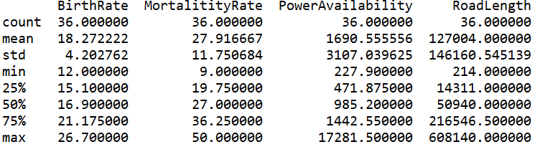



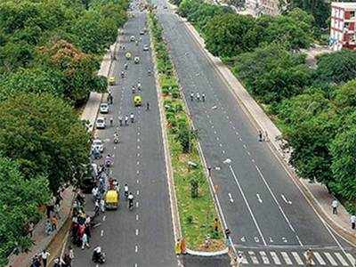
Know Your Data

Slide 7
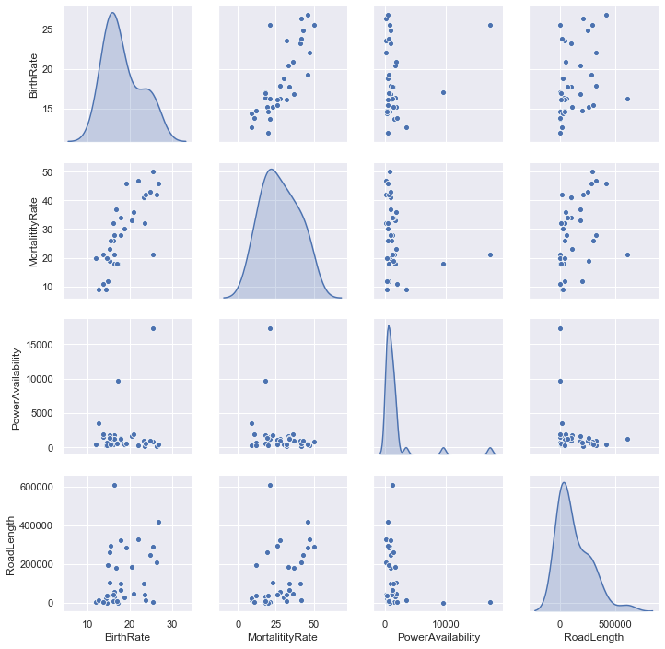
Know Your Data

Slide 8
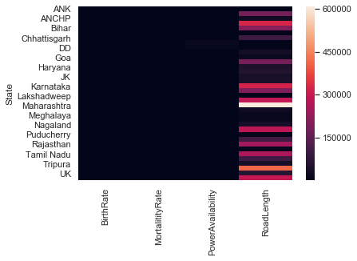
Know Your Data

Slide 9
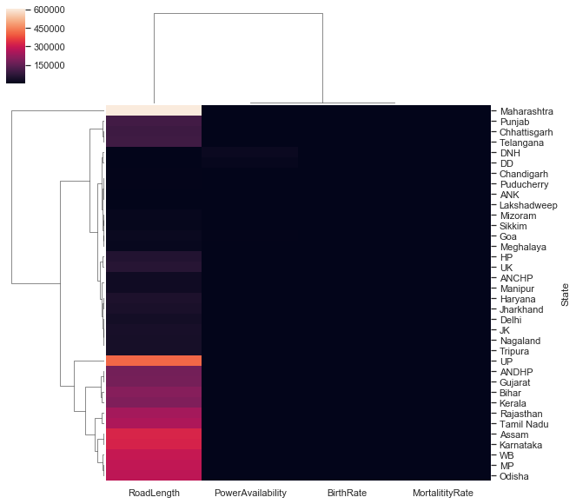
Know Your Data

Slide 10
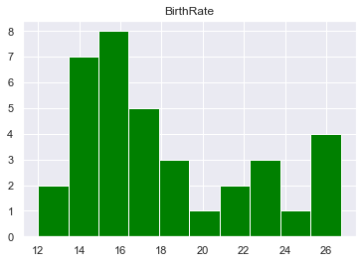
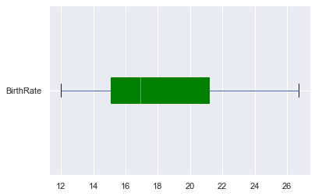
Know Your Data

Slide 11
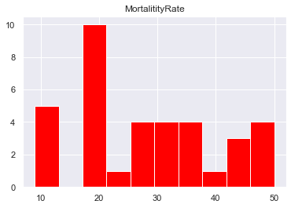
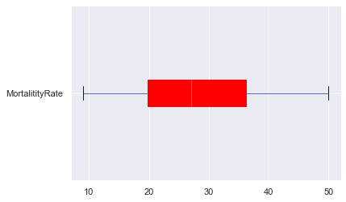
Know Your Data

Slide 12
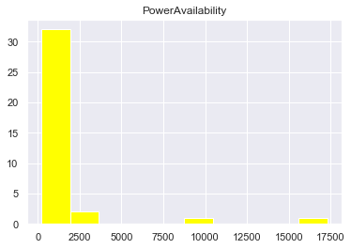
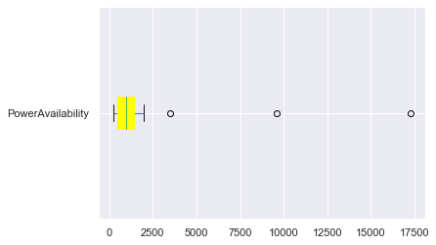
Know Your Data

Slide 13
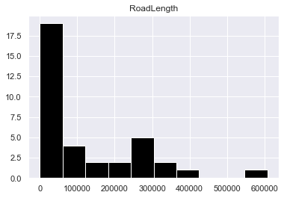
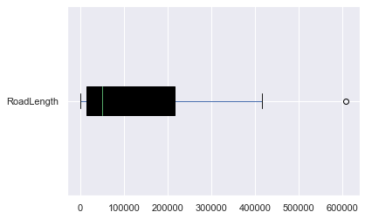
Know Your Data

Slide 14
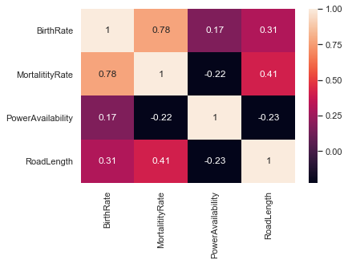
Correlation Matrix
of Data

Slide 15
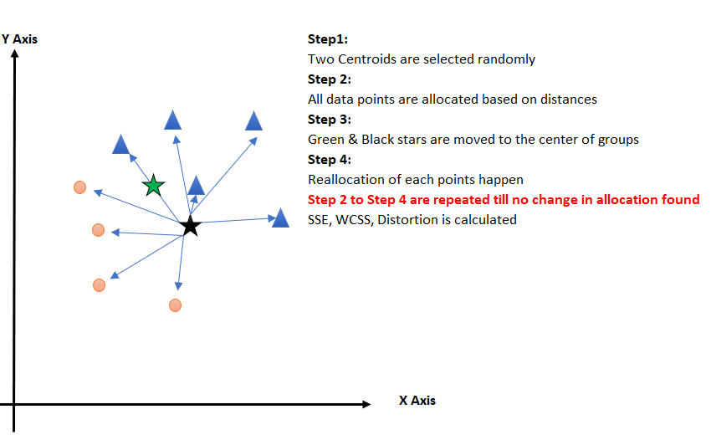
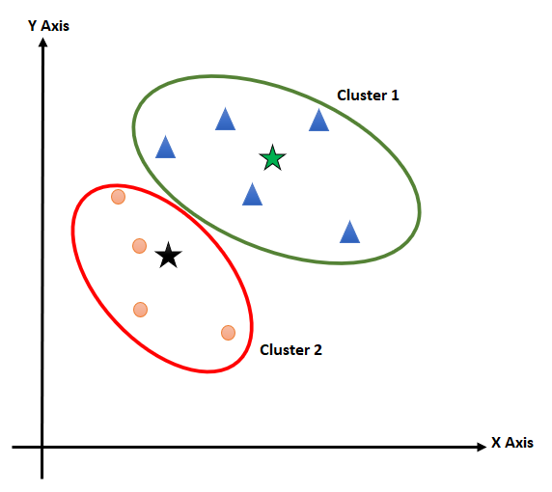
How K Means Clustering works?

Slide 16
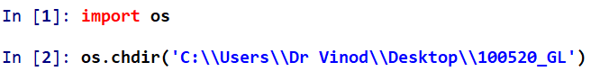
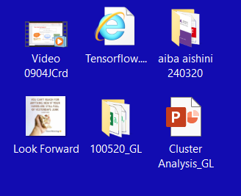
Create working directory

Slide 17
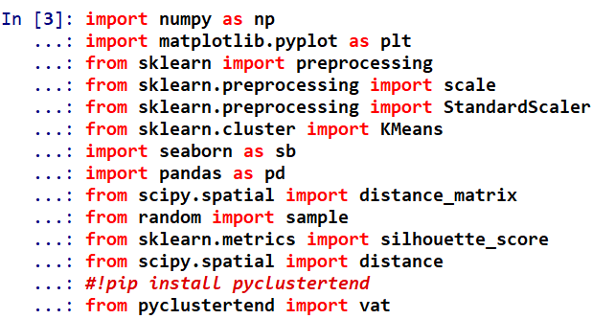
Import Libraries

Slide 18
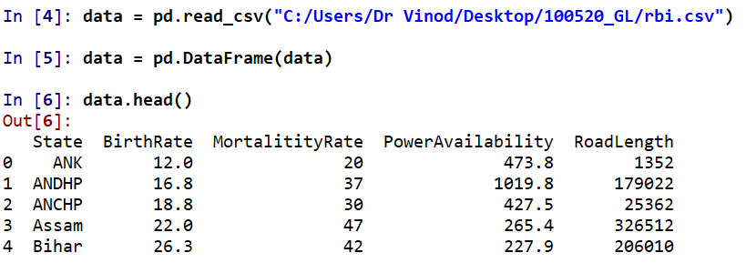
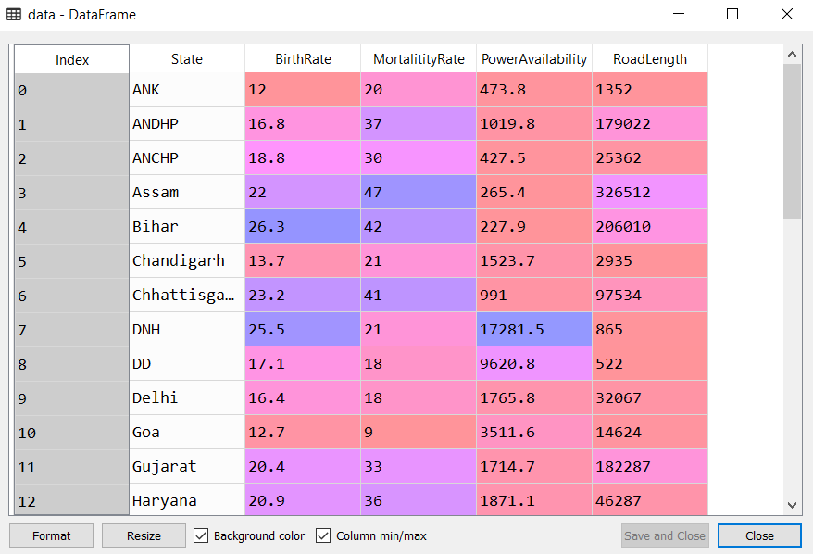
Import Data

Slide 19
Have a view

Slide 20
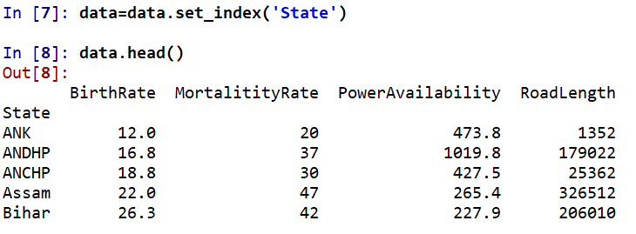
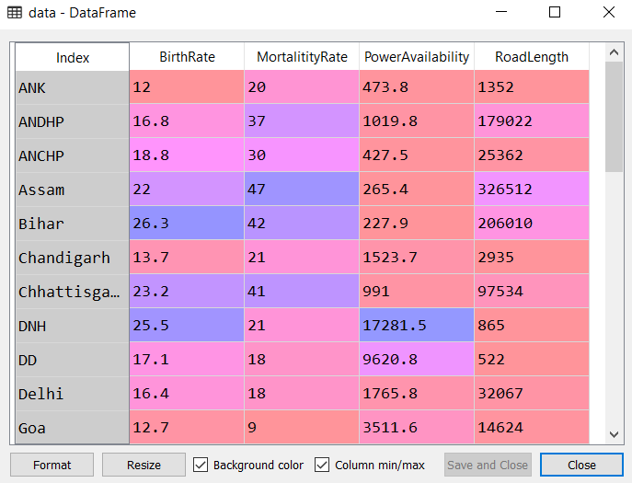
Lets bring State as index

Slide 21
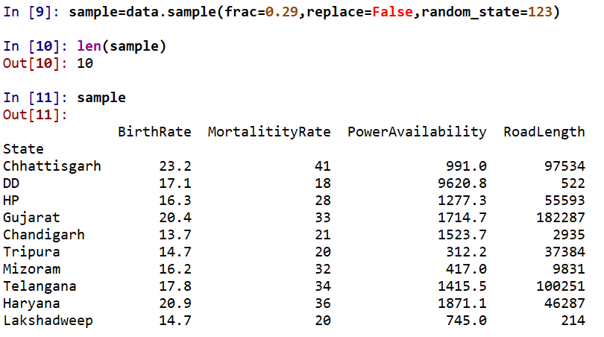
Take 10 random samples

Slide 22
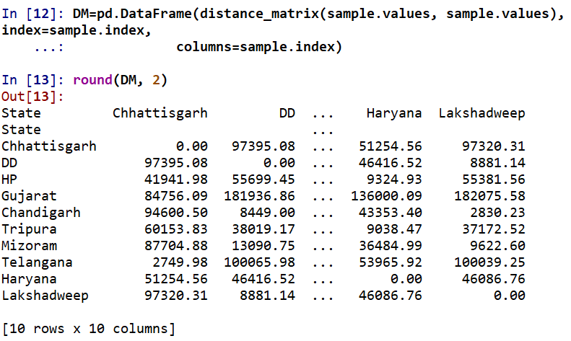
Distance Matrix

Slide 23
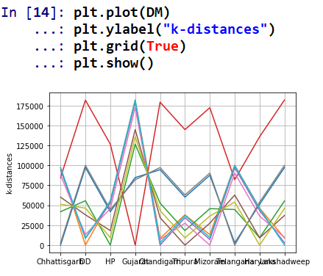
Plot Distance Matrix

Slide 24
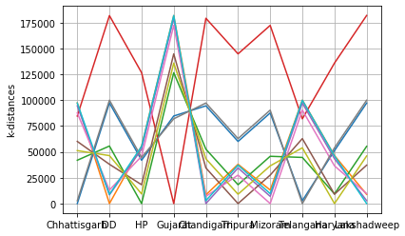

Slide 25
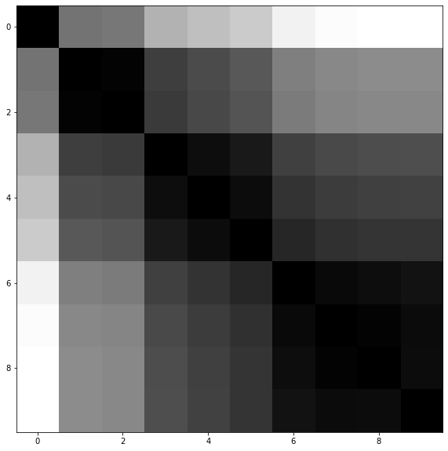
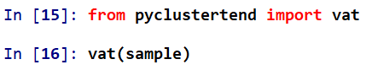
Visualize Distance Matrix

Slide 26
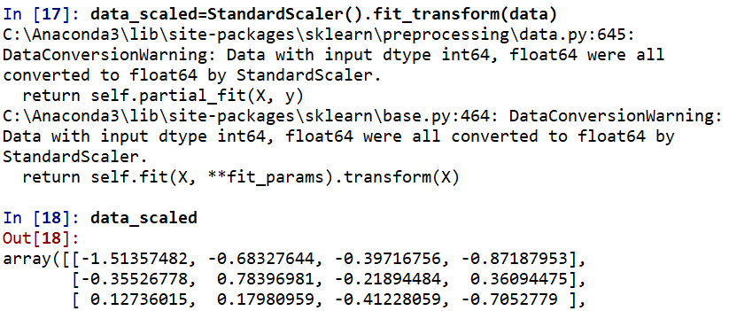
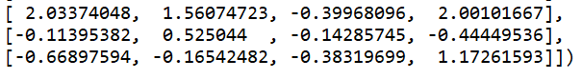
Let’s scale the Data

Slide 27
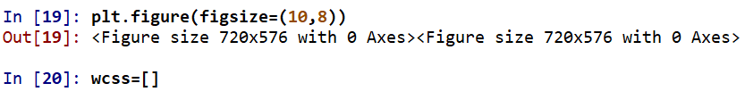
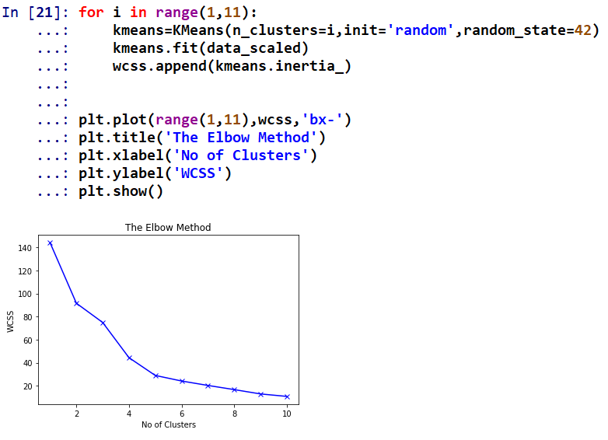
How many clusters
can be good?

Slide 28
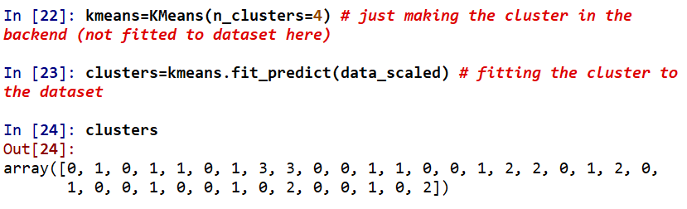
Cluster Membership

Slide 29
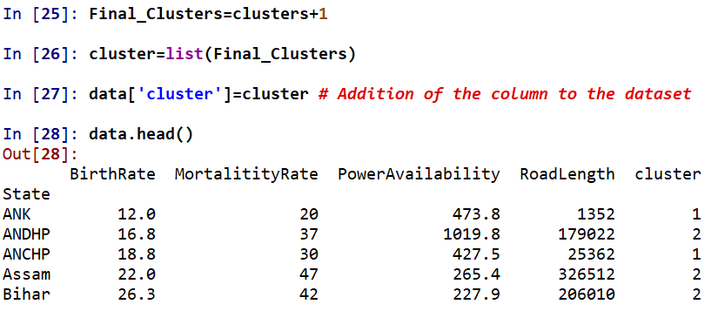
Let’s add column ‘cluster’ to the Data

Slide 30
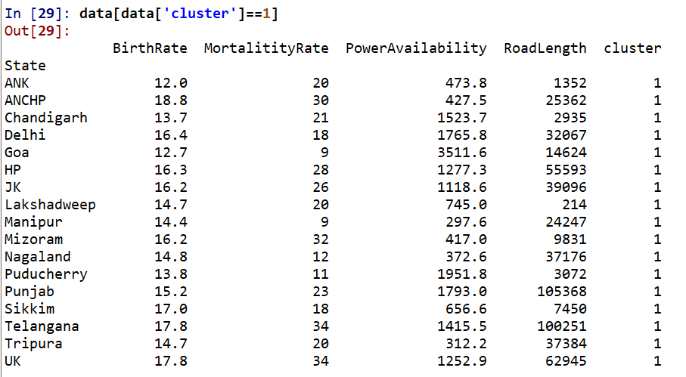
Cluster 1

Slide 31
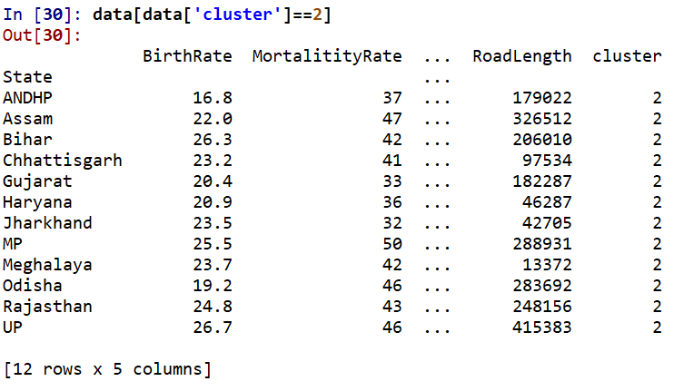
Cluster 2

Slide 32
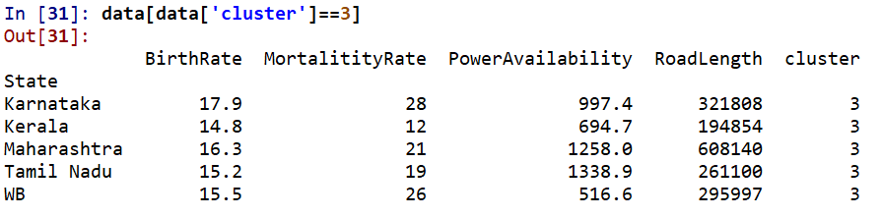
Cluster 3

Slide 33

Cluster 4

Slide 34

Cluster Profiling

Slide 35

Cluster Profiling

Slide 36

Plot Clusters

Slide 37


Slide 38

Silhouette Score

Slide 39



Slide 40

Picturization of Silhouette Coefficient

Slide 41

Expect some variation!

Slide 42

Average Silhouette Score

Slide 43

Silhouette Scores (4)

Slide 44

Silhouette Values

Slide 45

How Silhouette Score is calculated?

Slide 46


Slide 47


Slide 48



Slide 49
K Means: 3 Clusters

Slide 50

Plot of Three Clusters

Slide 51


Silhouette Scores in Three Clusters

Slide 52
Comparison of Silhouette Scores

Slide 53
Conclusion: K Means
Cluster 3 is more manageable
Cluster 3 has better Average Silhouette Score [0.40 versus 0.38]
Though three states Andhra Pradesh, Dadar Nagar Haveli & Karnataka had negative Silhouette Coefficient, but, the coefficients were very small (ignorable)

Slide 54


Hierarchical Clustering: ward method

Slide 55


Hierarchical Clustering: single method

Slide 56


Hierarchical Clustering: complete method

Slide 57


Hierarchical Clustering: average method

Slide 58



How Cophenetic Correlation is calculated? Average Linkage
Minimum is clubbed first, 0 & 1;
ANK and Lakshadweep

Slide 59


Stage 2

Slide 60

Stage 3

Slide 61
Stage 4

Slide 62


Final Correlation Matrix

Slide 63

Final Conclusion:
If data is large [My experience says more than 200 for being called as large], K Means else Hierarchical Clustering
As a good Data Scientist, don’t work in solos, involve beneficiary for final model, listen to him
Explain him pros and cons

Slide 64
Food For
Brain Storming

Slide 65


Food For
Brain Storming
Cluster_1
Cluster_2

Slide 66


Food For
Brain Storming
Cluster_3
Cluster_4

Slide 67



Slide 68



